Slide 1
The Angular Flow
How an Angular App Work Behind The Scenes

Slide 2
The Angular Flow
By flow, we mean how the files are called and in which sequence of files the app gets executed when we are developing it.

Slide 3
1. ANGULAR.JSON File
ANGULAR.JSON is the file which has various properties and configuration of your Angular project.
This is the file which is first referred by the builder to look for all the paths and configurations and to check which is the main file.
I have generated an angular hello-world app by the CLI.
Inside the angular.json file of this project, under the build section, you can see the options object as follows

Slide 4
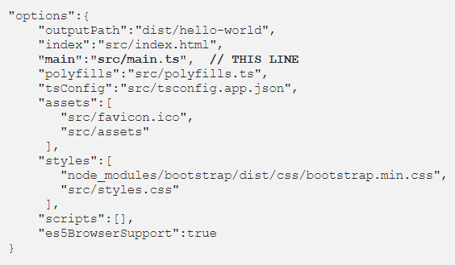
1. ANGULAR.JSON File
It has a reference to the main.ts file which tells the builder to start the app from there.

Slide 5
2. MAIN.TS
This file acts as the entry point of the application.
This entry point is defined in the internals of webpack that is used by Angular to support the modular functionality.
The path/name of the main file can be changed but it should also be changed in angular.json file.
Main.ts helps in creating the browser environment for the application to run.
This is done by

Slide 6

2. MAIN.TS
After this, main.ts file calls the function bootstrapModule(AppModule) which tells the builder to bootstrap the app.

Slide 7

3. APP.MODULE.TS
From the main.ts file, it is very clear that we are bootstrapping the app with AppModule.
This AppModule is defined in APP.MODULE.TS file which is found in
This is the module, created with the @NgModule decorator, which has declarations of all the components we are creating within the app module so that angular is aware of them.

Slide 8
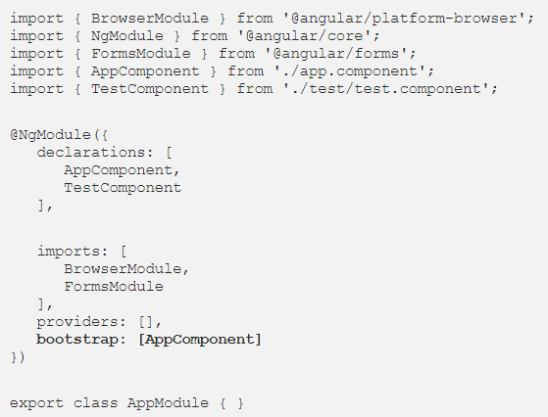
3. APP.MODULE.TS
Here, we also have imports array where we can import other modules and use in our app.
Below is an example of app.module.ts file with a test component declared and two modules imported.

Slide 9
4. APP.COMPONENT.TS
From the app.module.ts file above, we can clearly see that the module asks to bootstrap the app component.
This app component is in app.component.ts file.
This is the file which interacts with the html of the webpage and serves it with the data.
The component is made by using @Component decorator which is imported from @angular/core.
The component has a selector, which is like a custom html tag which we can use to call that component.

Slide 10
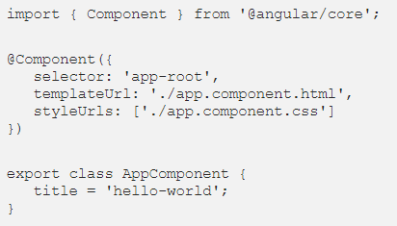
4. APP.COMPONENT.TS
It then has template or templateUrl which contains the html of the page to be displayed.
It also has the styleUrls array where component specific style sheets can be placed.
This is how a component file looks
By this time, compiler has all the details about the components of the app and now they are ready to be used.

Slide 11
5. INDEX.HTML
Now, since angular is well aware of the modules, components, styles, scripts etc. which are required to display the page, it’s show time!
Here, the index.html file is called.
It is found in the src folder of the app.
Compiler dynamically adds all the javascript files at the end of this file. Since all the components are now known, the html file calls the root component that is app-root.
The root component is defined in app.components.ts which targets app.component.html.

Slide 12
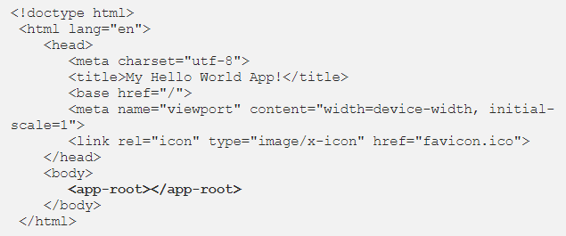
5. INDEX.HTML
This is how index.html file looks like in the coding environment

Slide 13
5. INDEX.HTML
In the body tag, you can see that a html like element <app-root></app-root> is present.
Well, this is our component selector for the AppComponent which is defined in app.component.ts file.
It asks angular to load that component.

Slide 14
6. APP.COMPONENT.HTML
This is the file which contains all the html elements and their binding which are to be displayed when the app loads.
Contents of this file are the first things to be displayed.

